Slide 1
LibEr E-Commerce Book Store
Scott Pelletier & Dongguo Wu

Slide 2
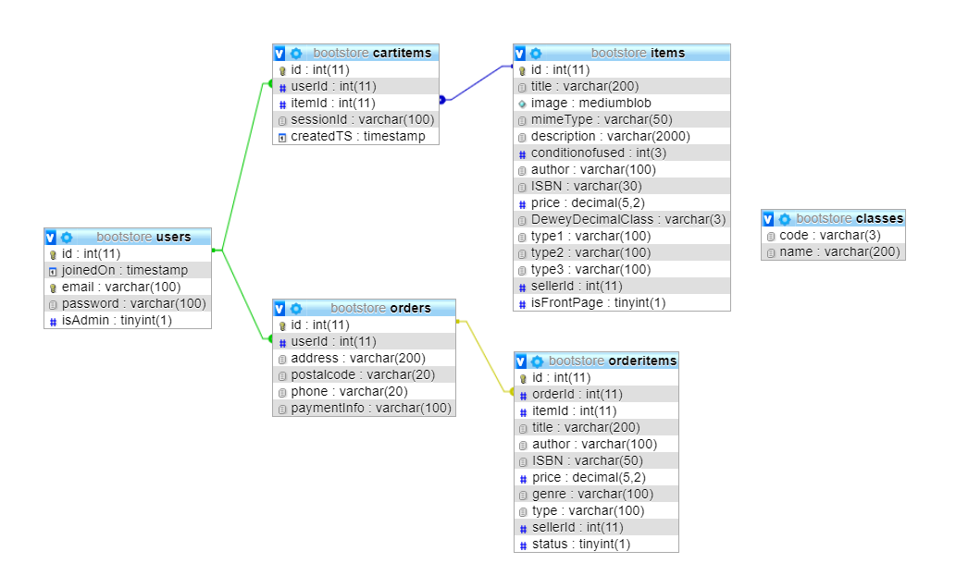
Database Structure:

Slide 3
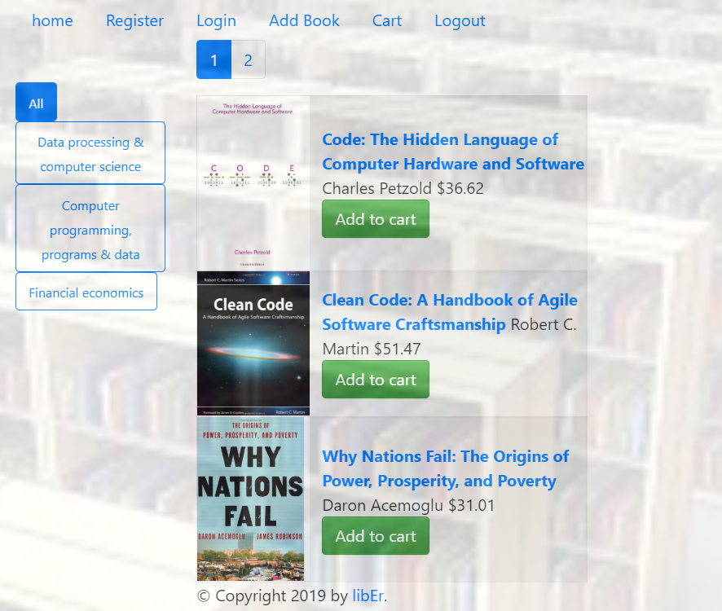
Database Structure: Cart

Slide 4
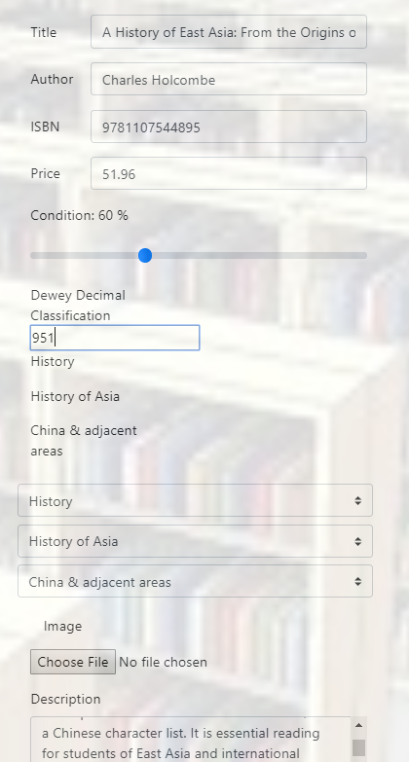
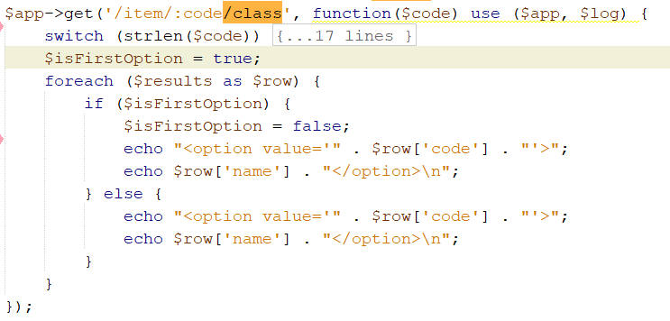
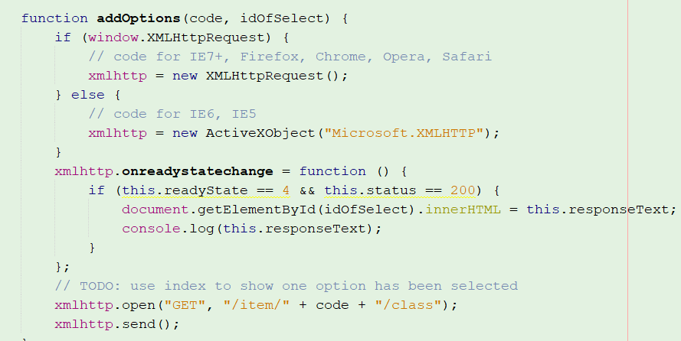
User Cart Cart.html

Slide 5
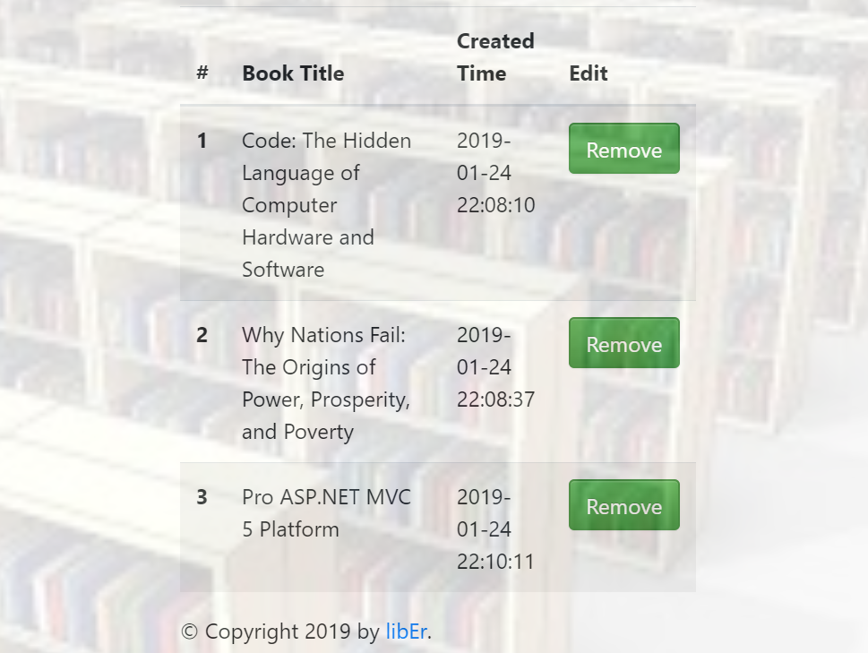
Main Page: index.html

Slide 6
Database Structure: Cart

Slide 7
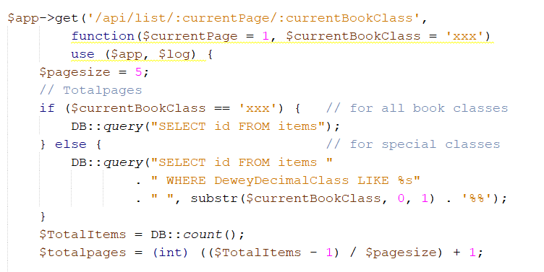
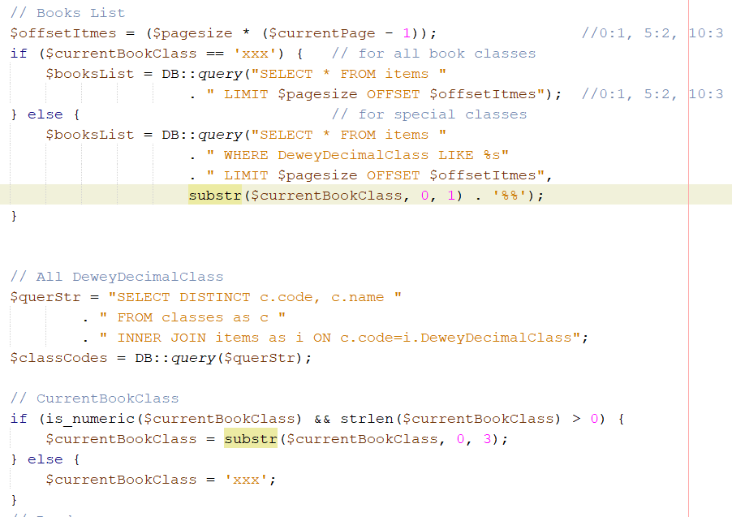
Database Structure: Cart
1
2
3
4
5
5

Slide 8
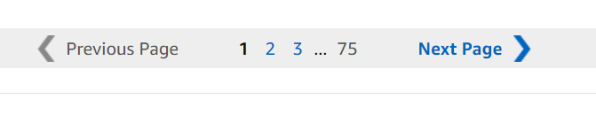
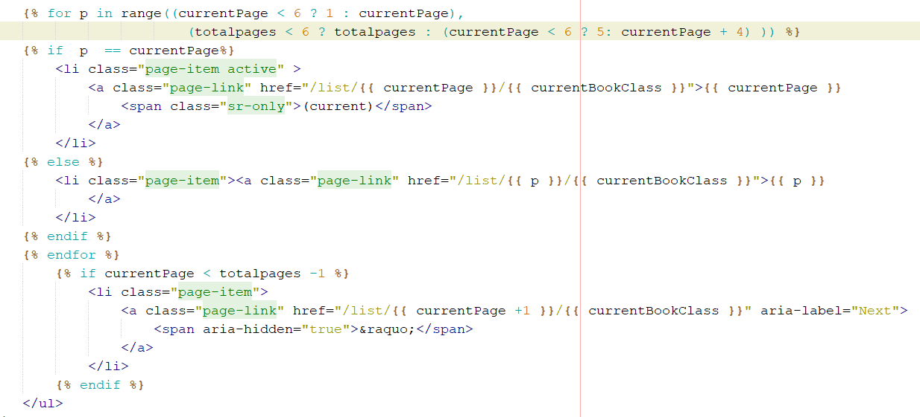
DeweyDecimalClass

Slide 9

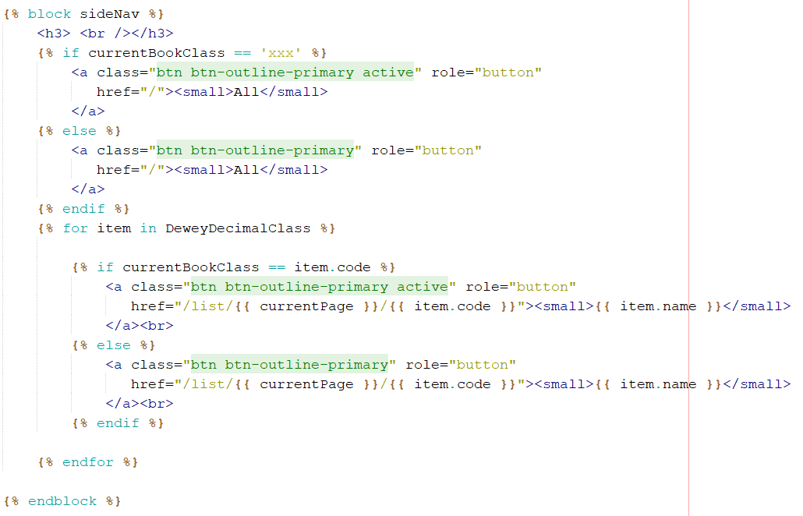
Pagination

Slide 10
DeweyDecimalClass
technology | Completeness | detail application
Fileupload | 100% | Upload product images
CRUD | 100% | List, add books and add books to cart Shows cart and transactions
Azure | 100% | Database is placed on Azure
Pagination | 100% | List boos based on page and category
AJAX | 100% | Show the books categoris when add book
PHP Md5 Password Decode
AJAX | future | Display the books list

